Slide 1
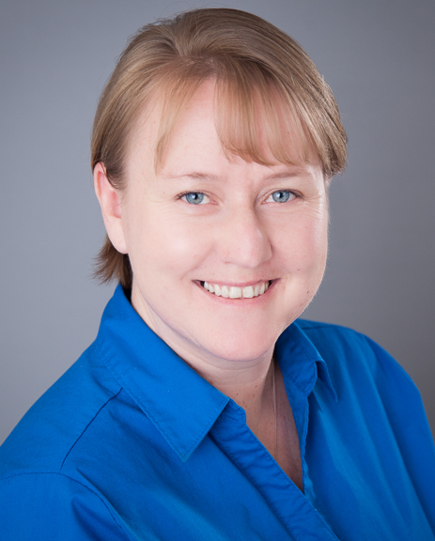
Telling the CEF Story
Raelyn Pracht
(Workbook Page 21)

Slide 2
Telling the CEF Story
Raelyn Pracht

Slide 3
Public Speaking Misconceptions
Professional public speakers don’t get nervous
You must use PowerPoint
Everyone will know how nervous you are
The best speeches are memorized
That you have all the answers

Slide 4
Public Speaking Facts
The fear of public speaking is called “Glossophobia”
Fear of public speaking is the #1 phobia
3 out of 4 people fear public speaking
The audience is on your side
Churchill, JFK, Thatcher and Elvis all feared public speaking

Slide 5
The Three “Knows”
KNOW your Audience
KNOW your Objective
KNOW the CEF Story

Slide 6
Remember This:
“All speaking is public speaking whether it’s to one person or a thousand”
~ Roger Love

