Slide 1
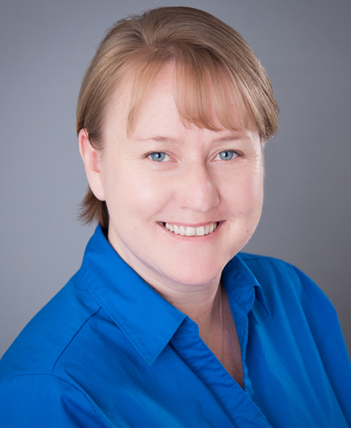
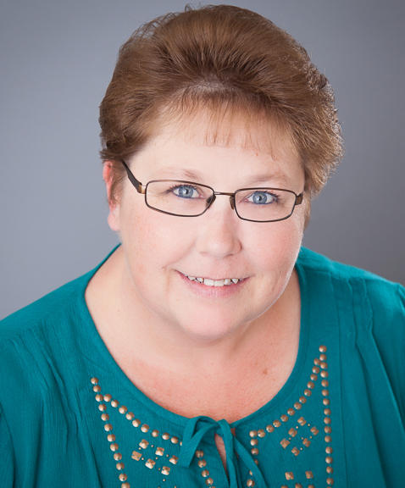
Raelyn Pracht
Debbie Morelos
K.I.D.S. Stamps & $uper $avers
(Workbook Page 35)

Slide 2
K.I.D.S. Stamps & $uper $avers
Raelyn Pracht and Debbie Morelos

Slide 4
What does K.I.D.S stand for?

Slide 5
Kids Into Discipleship and Stewardship

Slide 6
What denominations do the
K.I.D.S. stamps come in?

Slide 7
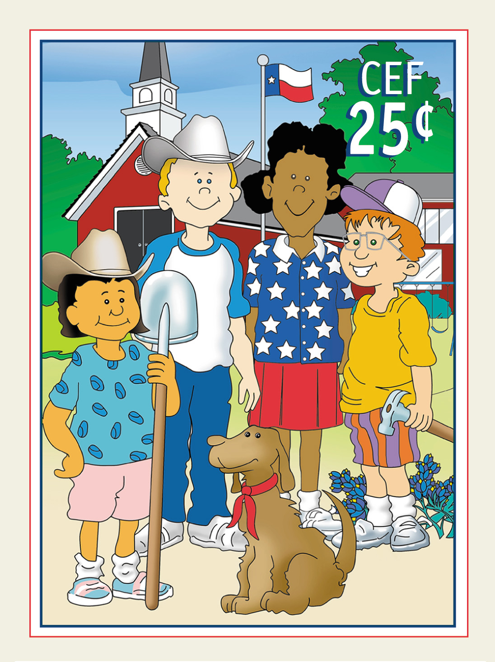
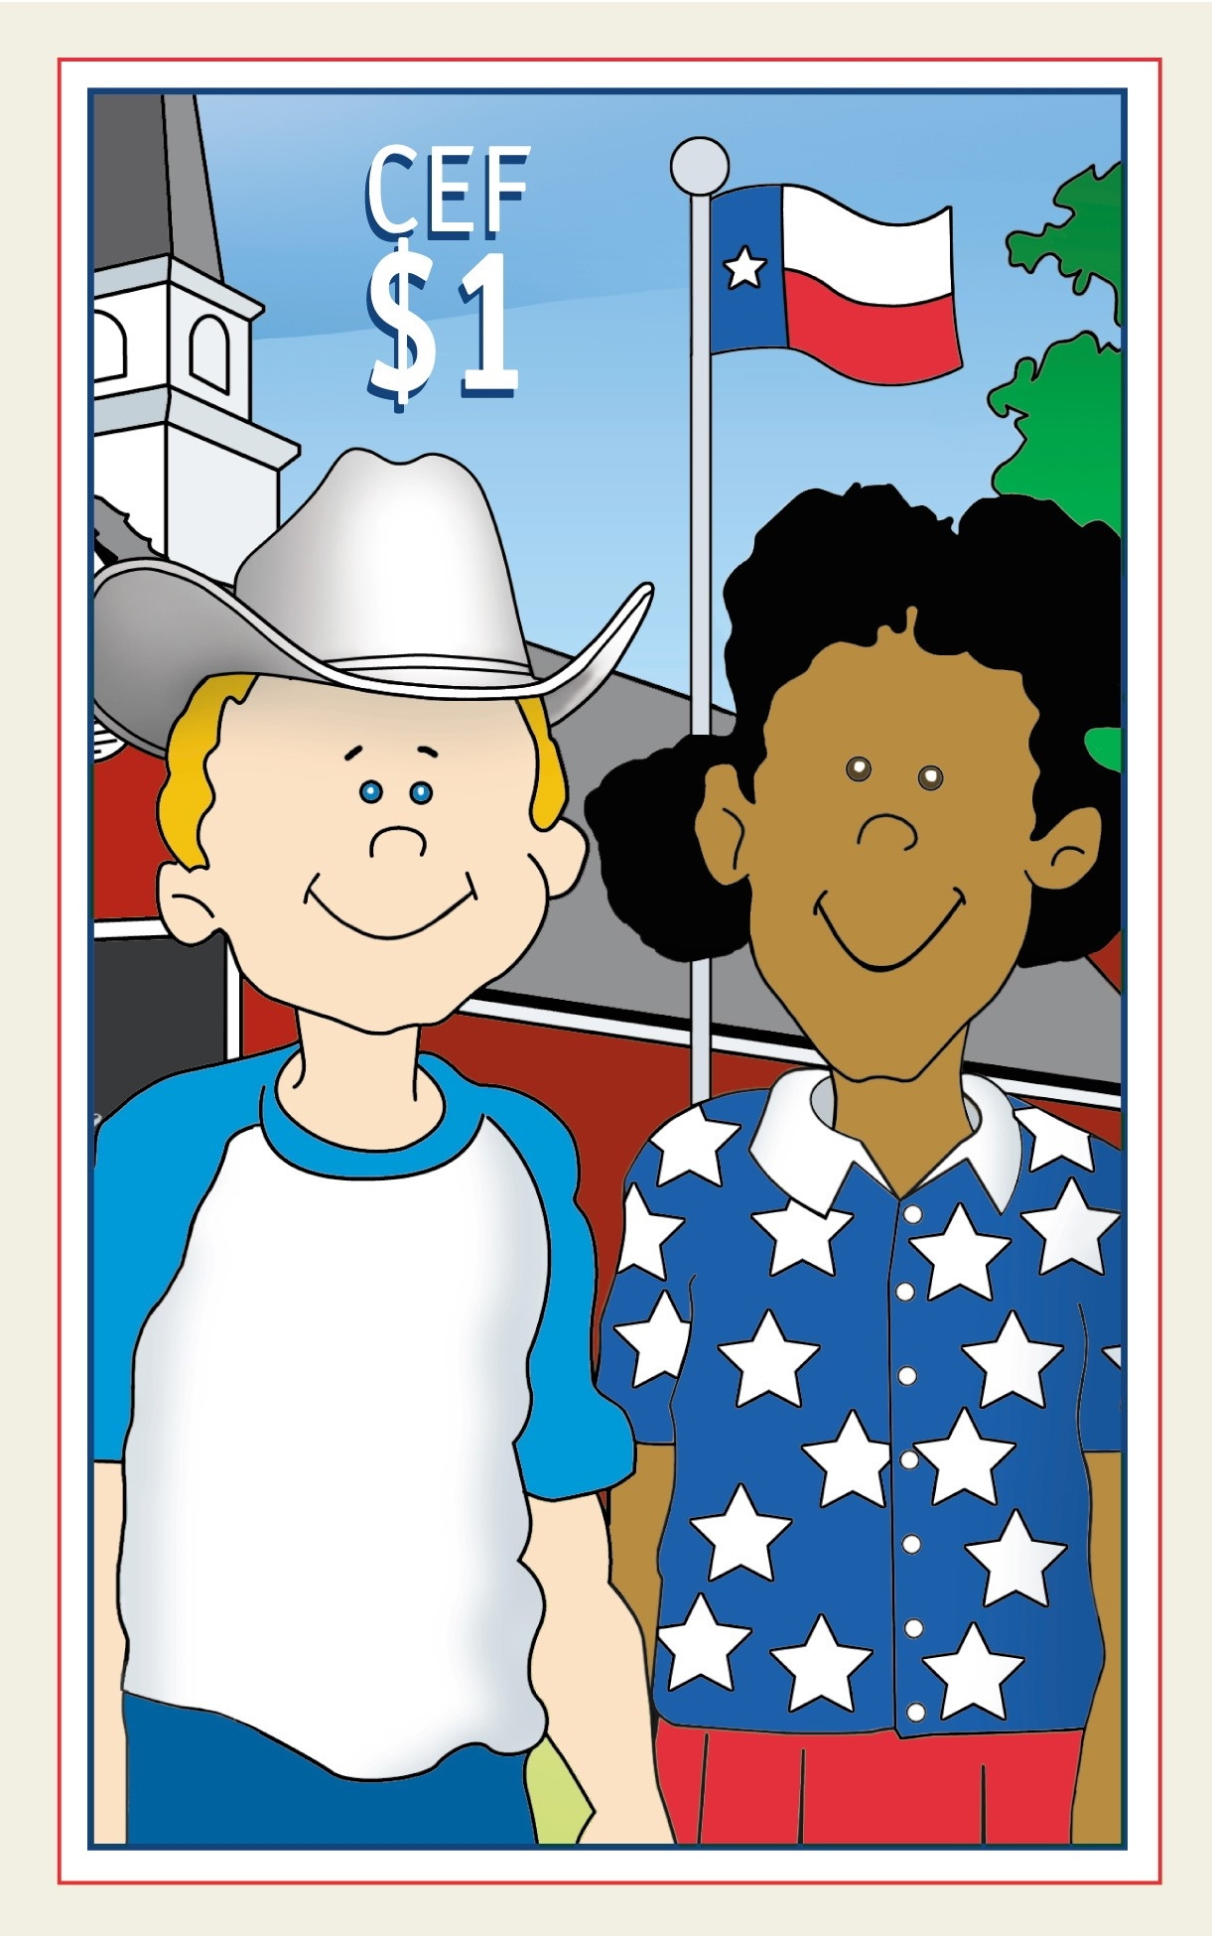
25 cents and $1.00

Slide 8
How do I order K.I.D.S Stamp pads?

Slide 9
Complete and mail, fax or e-mail an order from to
Texas CEF

Slide 10
How does my congregation pay for stamp pads?

Slide 11
Send a check with the order form, or order on consignment.

Slide 12
Send a completed consignment form that is signed by authorized congregation representatives. Then order stamp pads. As money is collected from stamp sales, send a check to Texas CEF for the amount collected.

Slide 13
What kind of promotional materials does Texas CEF provide?

Slide 14
Posters, brochures and stamp booklets. All promotional items are free of charge.

Slide 15
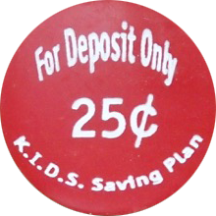
What is this red coin for?

Slide 16
The red coin is given with each investment of at least $10 by a child. The coin can mailed in with the next investment and an additional 25 cents will be added to the child's deposit.

Slide 17
What is $uper $avers and can
K.I.D.S stamps be used for this program?

Slide 18

Debbie Morelos will now present Super Savers and will answer that question and more.

Slide 19
Since the start of 2015,
Texas CEF has been promoting a program that teaches children ages 0 - 18 about stewardship, discipleship, and financial responsibility…

Slide 20
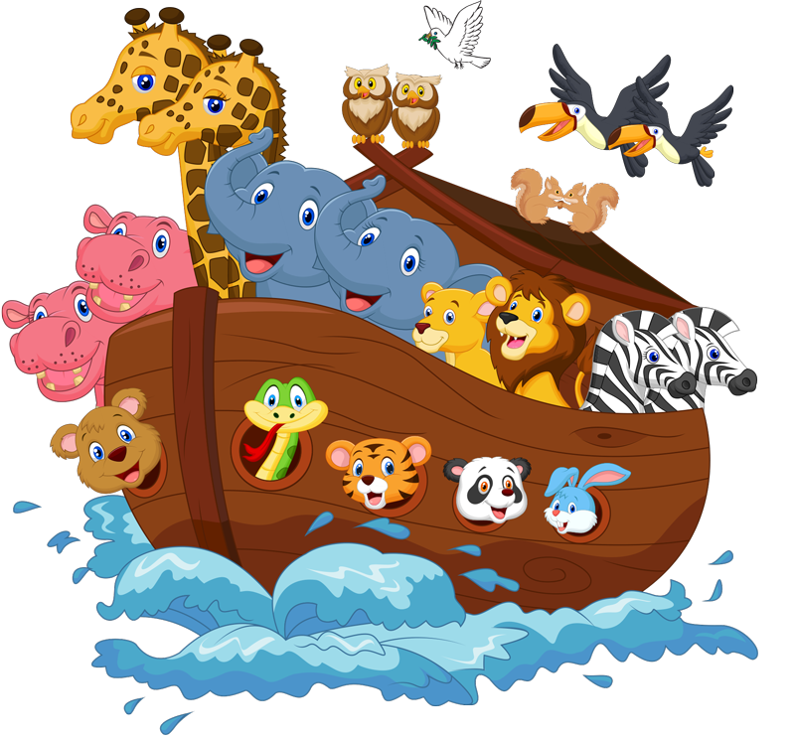
Noah’s Ark

Slide 21
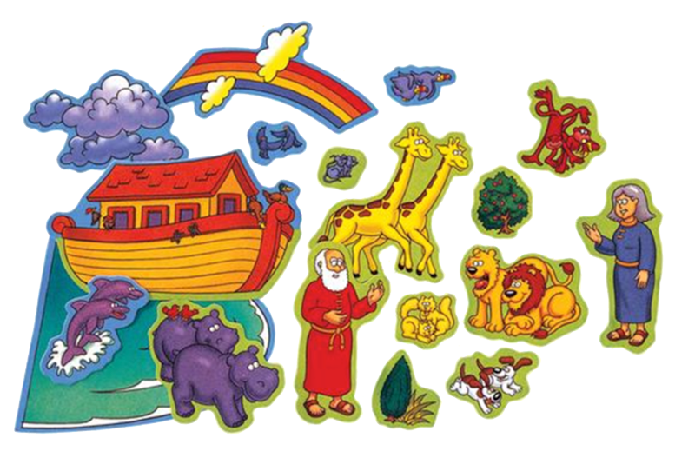
For each month the child invests at least $10.00, they will receive a
Noah's Ark felt piece and a coin. For the first investment, the child will receive the Ark, The wave, a dove, a Noah's Ark story handout, a congratulations letter, and a yellow Ziplock bag to store all the pieces in. After the first investment, each month that the child makes an investment of at least $10.00, they will receive different pieces to complete Noah's Ark .

Slide 22
A child makes their first investment of at least $10.00 into CEF by either opening a new investment or placing it into an existing one, they will automatically be enrolled into CEF's $uper $aver program.
If the child is already a $uper $aver member, Great! Their membership will automatically roll over into the Noah's Ark program but will receive a brand new membership card.

Slide 23
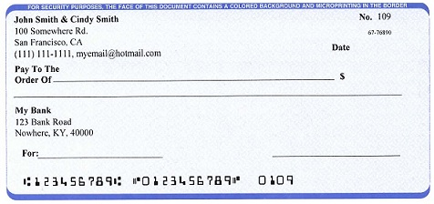
Any type of investment counts, whether it’s a check, K.I.D.S. stamps or CEF $.25 red coins.

Slide 24
They will receive a prize for each month they invest at least $10.00 into their CEF Flex Savings or any Floating rate note.
Investments do not have to be continuous every month, however, the more monthly $10.00 investments the child makes, the closer they will be to completing Noah's Ark.
Only one investment per month will earn the felt pieces. If more investments are made within the same month, the child will receive some other type of prize and a coin.

Slide 25
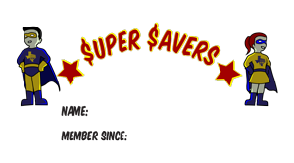
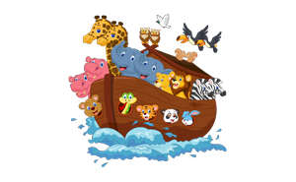
Once the child has made an investment each month for six months, they will receive a membership into the $uper $avers Club.

Slide 26
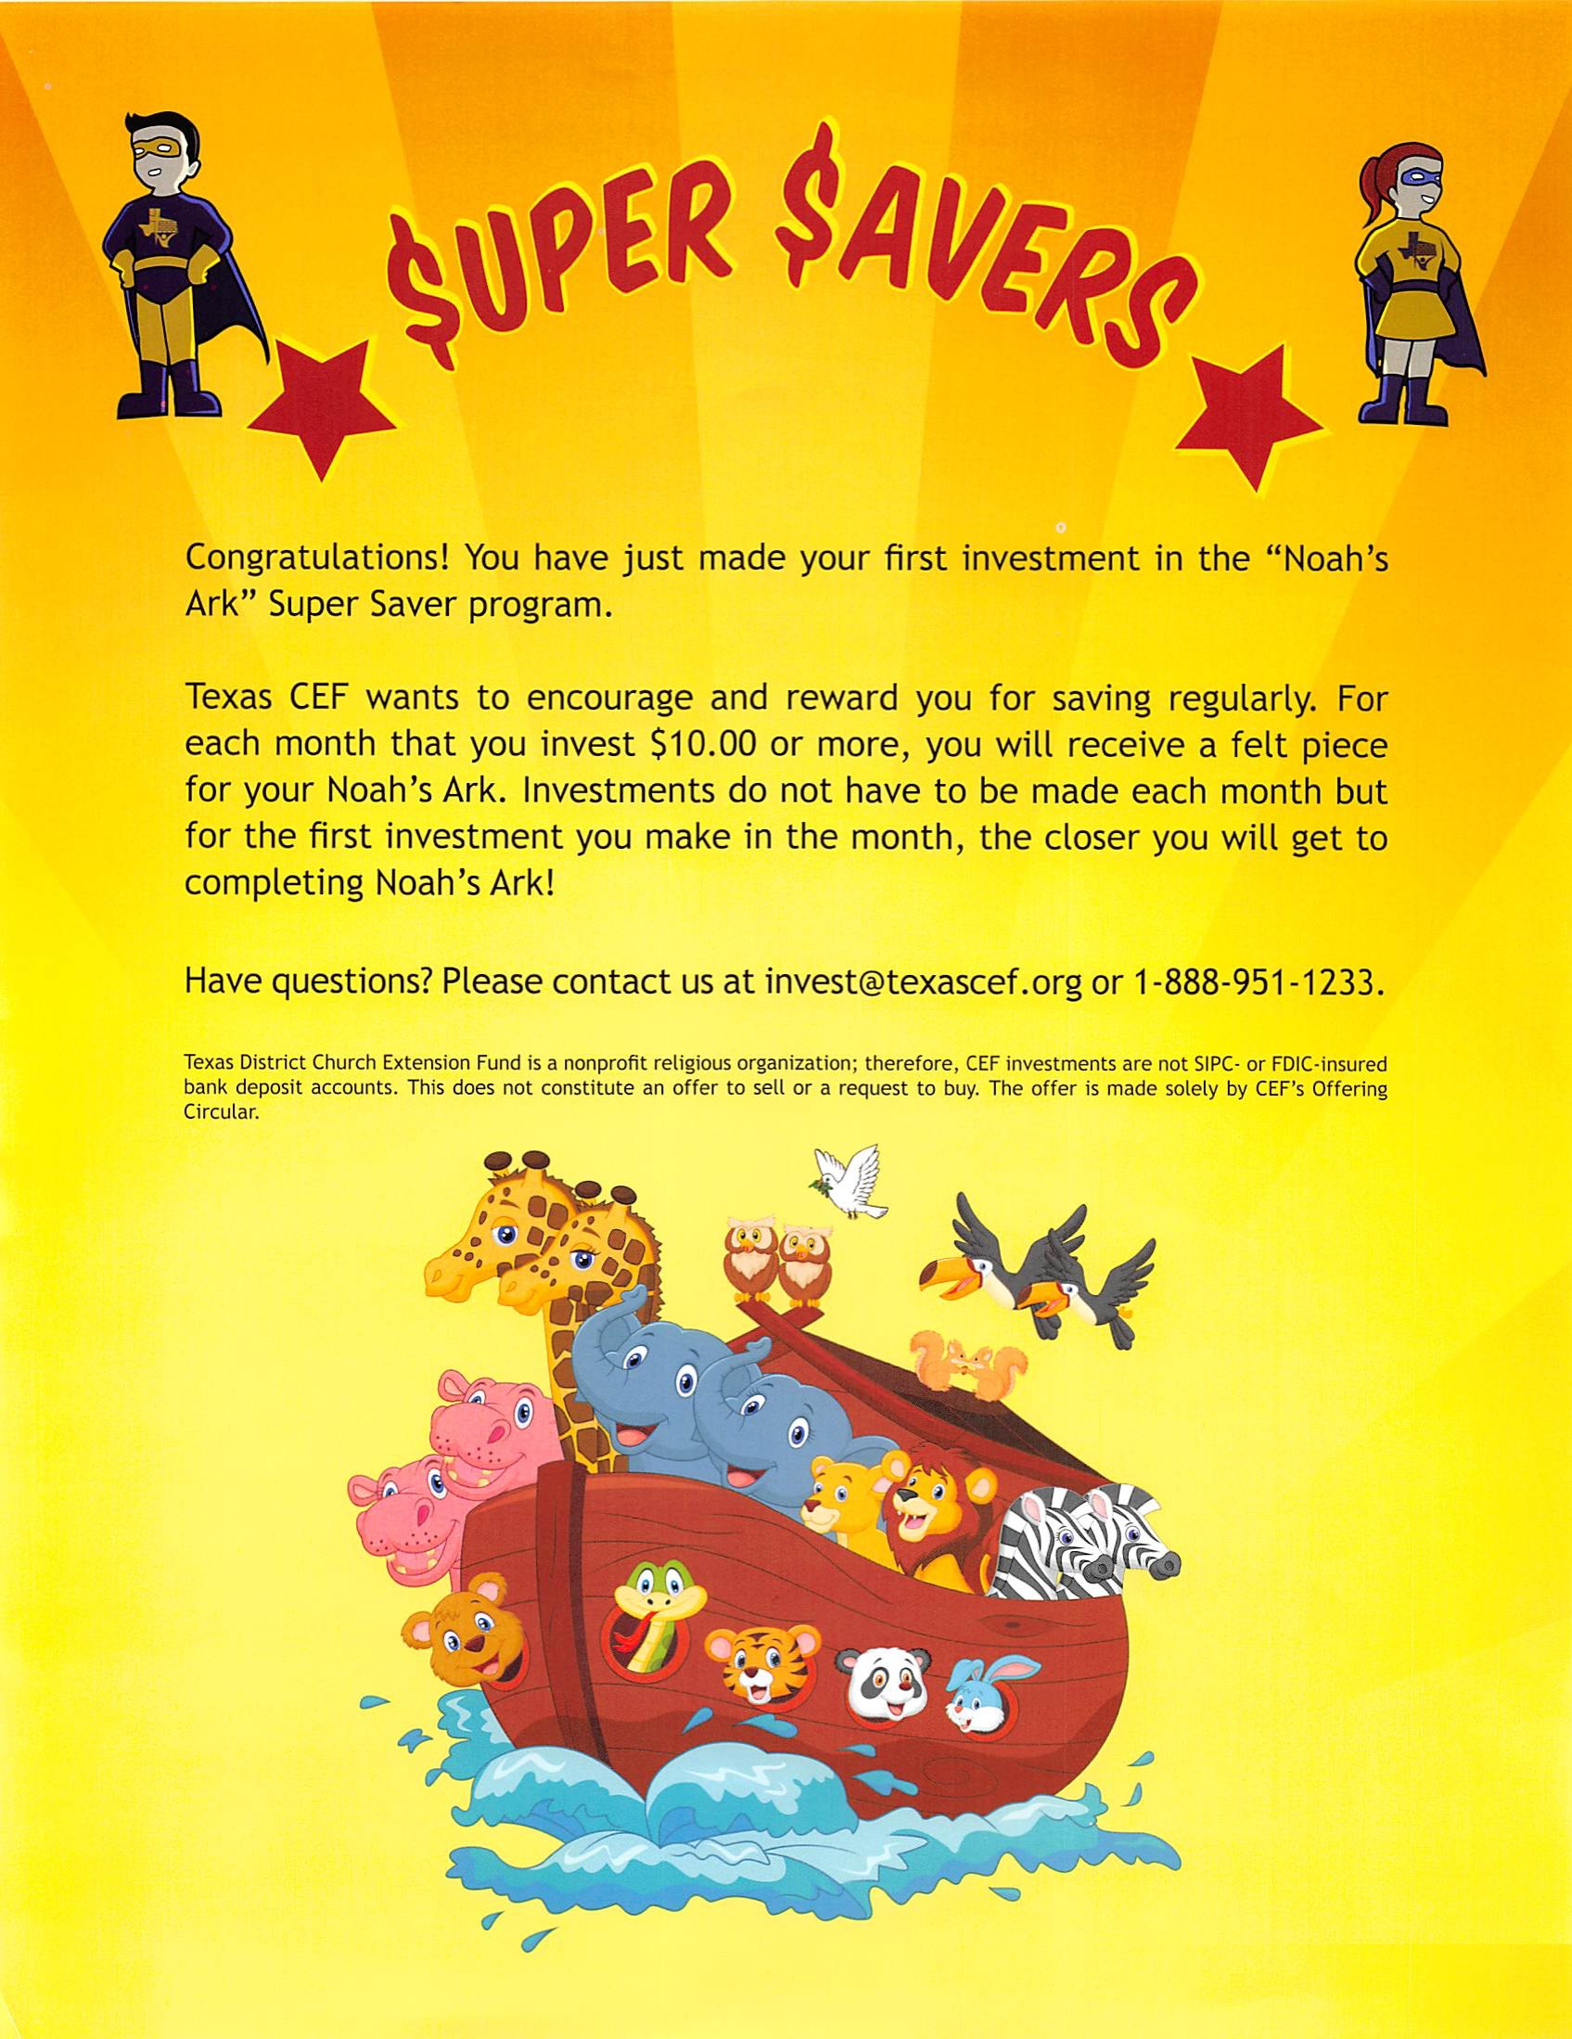
Membership will include a membership card and a monthly newsletter.

Slide 27
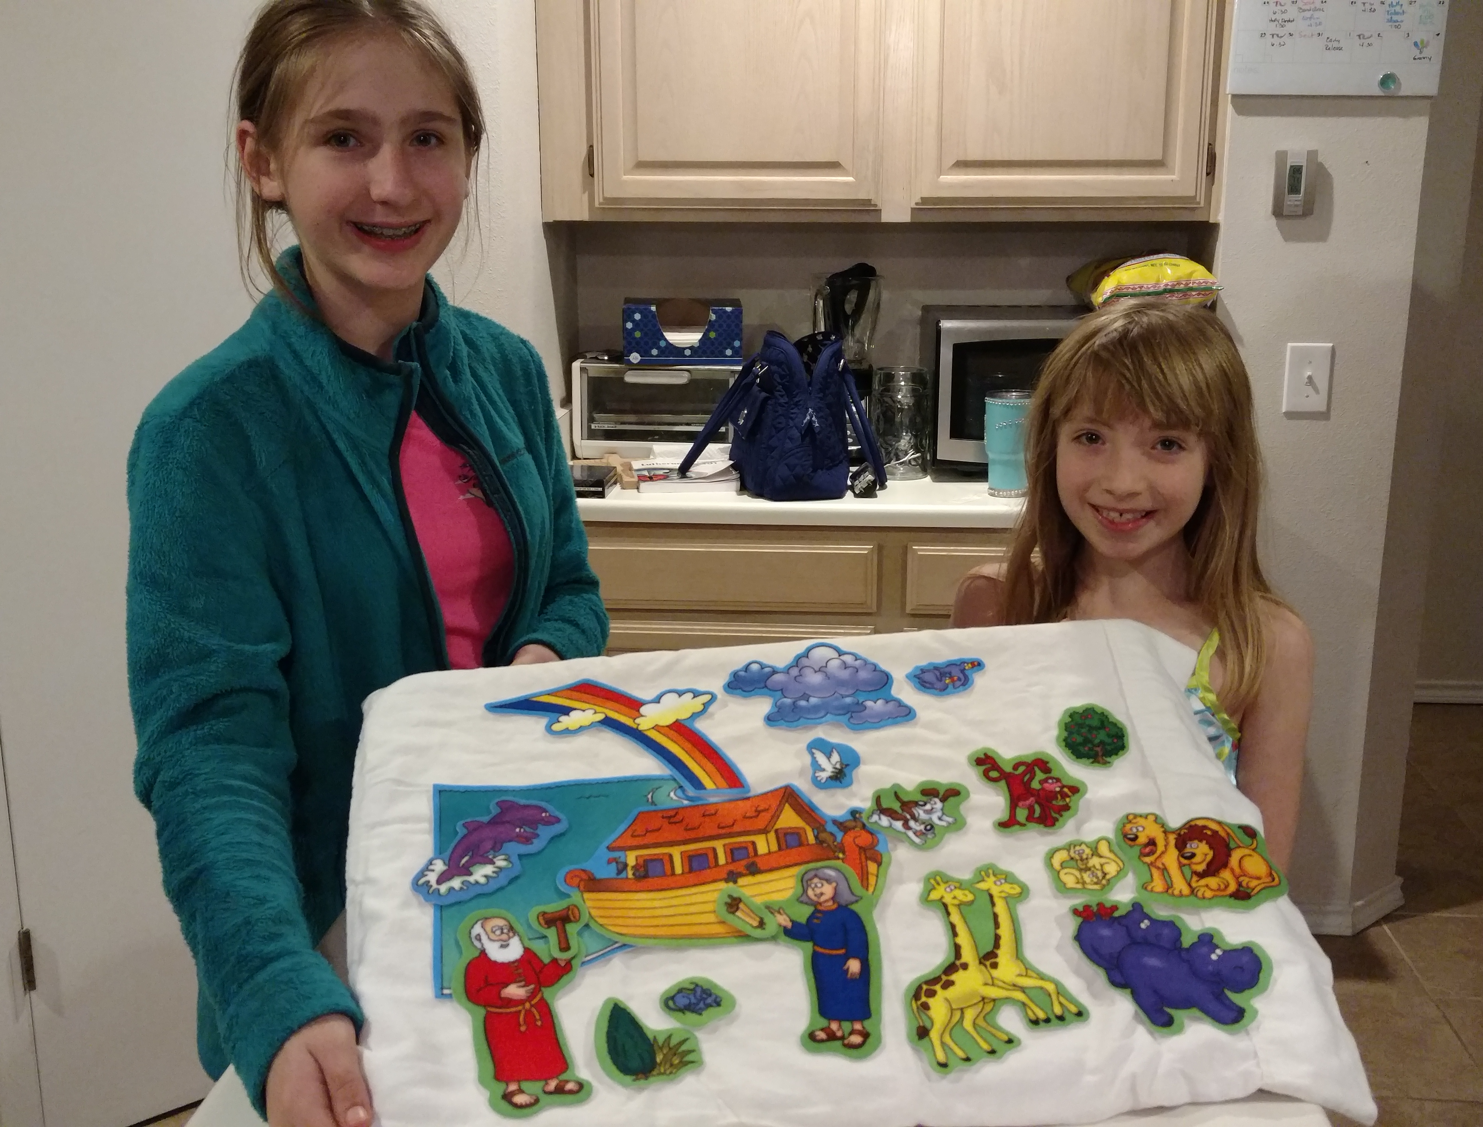
After the first six continuous investments, be sure to have parents sign photo consent form and send it back to CEF along with a picture of the child with the supersaver prizes for a chance to be shown in the $uper $aver newsletter.

Slide 28
Thank You!

