Slide 1
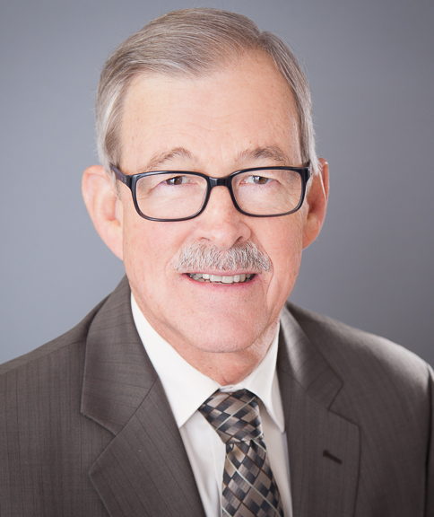
I Love to Tell the Story
Rev. Ken Hennings
(Workbook Page 33)

Slide 2
The Parable of the Sower
Matthew 13:3-9
³ Then he told them many things in parables, saying: "A farmer went out to sow his seed. ⁴ As he was scattering the seed, some fell along the path, and the birds came and ate it up. ⁵ Some fell on rocky places, where it did not have much soil. It sprang up quickly, because the soil was shallow. ⁶ But when the sun came up, the plants were scorched, and they withered because they had no root. ⁷ Other seed fell among thorns, which grew up and chocked the plants. ⁸ Still other seed fell on good soil, where it produced a crop – a hundred, sixty or thirty times what was sown. ⁹ Whoever has ears, let them hear."

